Slide 1

Green Pace
Security Policy Presentation
Developer: Summer Stinnett

Slide 2
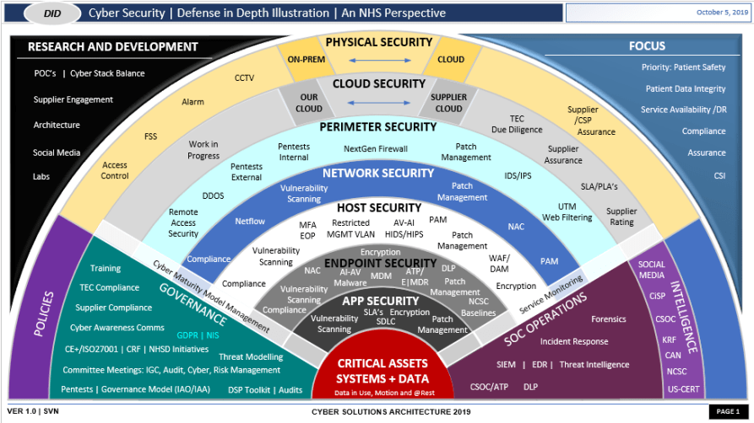
OVERVIEW: DEFENSE IN DEPTH
Green Pace requires consistent implementation of secure principles to all parts around the product. Consistent, layered approaches and methodologies must be implemented within all procedures and supported over time to help ensure a stable, secure platform for the product.
Notes:
[Introduce your security policy. Explain why it was needed and how it will be used to support the defense-in-depth best practice.]

Slide 3
THREATS MATRIX
Likely:
High chance to cause issues
Unlikely:
Low chance to cause issue
Priority:
Likely to occur as well high severity potential
Low Priority:
Not likely and/or low severity
Likely STD-002, STD-005 | Priority STD-004, STD-007, STD-008
Low priority STD-009 | Unlikely STD-001, STD-003, STD-006, STD-010

Slide 4
10 PRINCIPLES
Principle | Associated Coding Standard(s)
Validate Input | STD-004: SQL Injection, STD-008: Input Validation
Heed Compiler Warnings | STD-001: Data Types, STD-009: Integer Overflow
Architect and Design for Security Policies | STD-006: Assertions
Keep It Simple | STD-003: String Correctness, STD-001: Data Type
Default Deny | STD-007: Exceptions

Slide 5
10 PRINCIPLES (Cont)
Principle | Associated Coding Standard(s)
Adhere to the Principle of Least Privilege | STD-008: Memory Protection
Sanitize Data Sent to Other Systems | STD-002: Data Values, STD-003: String Correctness, STD-009: Integer Overflow
Practice Defense in Depth | STD-003: String Correctness, STD-004: SQL Injection, STD-008: Memory Protection
Use Effective Quality Assurance Techniques | STD-006: Assertions
Adopt a Secure Coding Standard | STD-005: Memory Protection, STD-010: Resource Management

Slide 6
CODING STANDARDS
Rule | Description
Data Type (STD-001) | Selecting the correct data type prevents data truncation, overflow, and unintended behavior.
Data Value (STD-002) | Proper data value validation ensures that values fall within acceptable ranges for the application.
String Correctness (STD-003) | Developers should use safe string functions and avoid fixed-size buffers when possible.
SQL Injection (STD-004) | Parameterized queries prevent attackers from modifying the intended query structure.
Memory Protection (STD-005) | Proper memory management ensures reliability and security.
Assertions (STD-006) | Assertions help detect programming errors early by verifying assumptions during development and testing.
Exceptions (STD-007) | Exception handling allows programs to gracefully recover from unexpected errors instead of crashing.
Input Validation (STD-008) | Validating inputs prevents malicious data from affecting system operations.
Integer Overflow (STD-009) | Programs must verify numeric operations before execution.
Resource Management (STD-010) | While sources are automatically released when objects go out of scope, cautions should still be made while it is in scope.
Notes:
[List the 10 coding standards. Explain your own ranking system for vulnerabilities,using specific details from the coding standards in your security policy.]

Slide 7
ENCRYPTION POLICIES
Encryption at rest | Keeps stored data secure by using strong encryption methods like AES-256. The data remains protected even if someone gains unauthorized access to the storage system.
Encryption in flight | Encryption in flight protects data as it is being transferred. Using secure protocols like TLS prevents anyone from intercepting or tampering with the data while it’s being transmitted.
Encryption in use | Encryption in use focuses on protecting data while it’s actively being processed in memory. Technologies like memory protection help keep sensitive information safe even during runtime.
Notes:
[Explain the policies for encryption in flight, at rest, and in use.]

Slide 8
TRIPLE-A POLICIES
Authentication | Authentication confirms that users are who they say they are before granting access to the system or its resources. This can include methods like passwords combined with multi-factor authentication for entry points into the system.
Authorization | Authorization determines what a user is allowed to do. By using role-based access control, users are only given access to the information and actions necessary for their role.
Accounting | Accounting keeps track of what users do within the system with a log of activities like logins, file access, and database changes. These records provide visibility, support auditing, and help detect and respond to potential security incidents.
Notes:
[Explain the policies that support authentication, authorization, andaccounting.]

Slide 9

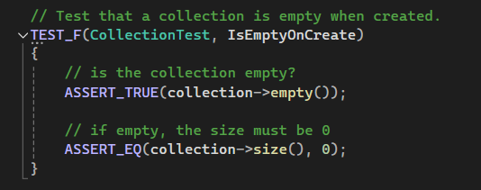
IsEmptyOnCreate
Test to ensure newly instantiated collections return true when checked for being empty as well as verifying their size is 0
Necessary to ensure there is no junk data being incorporated into the creation of a collection

Slide 10
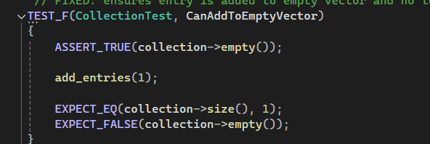
CanAddToEmptyVector
Validates that a collection can have an element added to it and its size reports as 1 (if starting from 0)
Necessary to ensure that collection objects can house the data necessary for proper processing

Slide 11
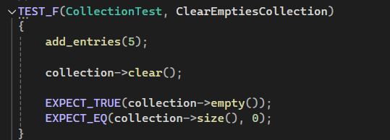
ClearEmptiesCollection
Validates that collection objects are properly purged from memory when cleared
Helps ensure that information that should not exists within memory is not floating around within the application if it shouldn't be

Slide 12
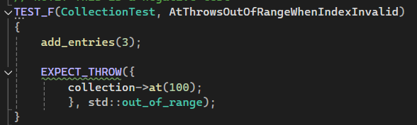
AtThrowsOutOfRangeWhenIndexInvalid
Validates that the index outside the bounds of a collection, when referenced, throws a proper exception with useful reason provided
Exception handling enables developers to securely plan for unexpected results

Slide 13
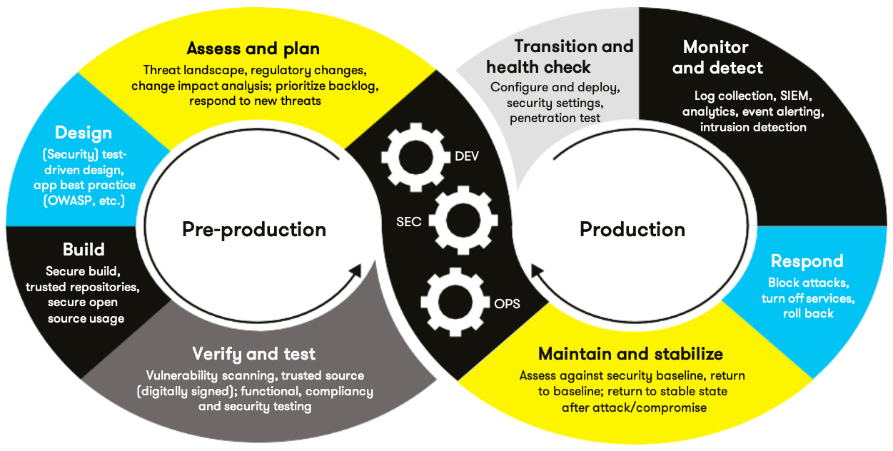
AUTOMATION SUMMARY

Slide 14
TOOLS
Clang-Tidy
  checks C/C++ code for bugs, style issues, and modernization improvements.
CppCheck
  static analysis tool focused on detecting bugs and undefined behavior in C/C++ without executing the program.
Valgrind
  runtime analysis framework that detects memory leaks, invalid memory use, and performance issues during execution
SonarQube
  platform for continuous code inspection that tracks bugs, vulnerabilities, and code quality across projects

Slide 15
RISKS AND BENEFITS
Risks
  Challenge to implement
    Huge time commitment
  Upholding standards in the team
    Regular training programs
  Could cause delays in product releases
Benefits
  Results in a better, more secure product
  Mitigates risk of losses of data or assets of both users and company
  Once fully set up, can make developers' job easier in some cases

Slide 16
RECOMMENDATIONS
    Potential Gaps
      Need time to train entire team
      Disconnects between business needs and security needs
      Introduces elements of lack of confidence in implementations which slows development

Slide 17
CONCLUSIONS
Assess and plan against potential risks
Be considerate of various standards and procedures
  IDE-integrated tools like Clang-Tidy used to catch issues early during development
  CppCheck will run to prevent insecure code from entering the repository
  Continuous integration tools like SonarQube will perform comprehensive scans and help ensure builds are successful
  During QA testing, dynamic analysis tools such as Valgrind and AddressSanitizer will be used to detect runtime issues
  Process will cycle with monitoring and improvement of practices

Slide 18
REFERENCES
Yankel, J., & Yasar, H. (2023, June 12). 5 challenges to implementing DevSecOps and how to overcome them. Carnegie Mellon University, Software Engineering Institute. https://doi.org/10.58012/fywc-yq50

